Slide 1
CZ
Client: Kylie Huard at the Dunedin City Council
Notes:
Good morning
My name is Zane, this is Cameron.
Our client for our project is Kylie Huard the Senior Transport planner for the DCC.

Slide 2
Value Proposition
This project is helping to address the issue of road cyclists safety with how vehicles are passing them. It has been in use since August 2015. During this time is has been recording vehicle passing speeds and distances showing the most problem areas where dangerous incidents have been occurring. It has shown that 35% of vehicles are passing cyclists dangerously.
Notes:
Our project a device for the DCC that cyclists use to record dangerous close encounters with vehicles.
The main deliverable of our project is not necessarily the device, but the data that the device records.

Slide 3
Functional requirements
The system must record how close cars are passing cyclists
The system must record where close passes have happened
The system must record when the close pass happened
The system must record data in a readable format
The system must have a way of getting the data to a meaningful place
Notes:
The system needs to be able to record how close cars have passed
Where/when these incidents have happened.
And this data needs to be able to be read by The DCC and be able to be interpreted easily.

Slide 4
Interaction Design
Try to keep interaction between user and system minimized
User pairs android device to Arduino initially
Users will be able to see the data they are collecting
DCC user will be able to see the collected data on a map
Notes:
The interaction with the device that the cyclists use,
needs to be kept at a minimum to ensure that data is correctly received.
Interaction between the cyclists and their phones will need to happen so that
they can pair their device initially via bluetooth, so the device can
communicate with the users phone for sending data.
Unfortunately we did not for see us using mobile until recently, so we did not
Do any paper based prototyping , but we are hoping to do some paper based
prototyping very soon.
The users will have to fit the device on them selves, we have not full
Come to terms on how the user will do this. Our first thought was to fit the
device on a belt strapped around the users waist. We have also thought about
integrating the device into a wearable piece of clothing such as a high-vis vest.

Slide 5
System/software architecture
Hardware
Arduino
Sonar sensor
Bluetooth
Software
Mobile interface
Interface for DCC
Notes:
We chose Arduino as our controller for the device because
we have readily available access to them and we have prior experience with them.
Arduino has a big community behind it, so trouble shooting and asking for help is not a problem.
Arduino also has a lot of available libraries for the wide range of sensors and components. Arduino is also open source.
We are using sonar sensors for our project to measure distances and detect cars.
The particular sensor we are using for this is the HC-SR04 and the main reason we are using this sensor is that it is easy to use, and the polytech has made available an abundance of these to us. We are using a library with the sensor at the moment called new ping, this library is easy to use and it outputs and easier value to deal with.
We are using a Bluetooth module to communicate with a android phone, in order to gain access to the phones resources. The resources that we want from the phone are gps, time, and the ability to send data through the internet.
We will have a mobile app that sends and receives data, and also allows the cyclist to view the data they have collected.
We will have DCC front end for the viewing of our collected data. The user will be able to see the data displayed on a map, so that they can get a clear view where the problem areas are in Dunedin.

Slide 6
Target Deployment Environment
Arduino - Device for gathering our data
Android – to interact with Arduino
Desktop for DCC user interface
Notes:
For Arduino development it is using the languages c and c++. To develop for this we are using the default Arduino IDE.
For android development we are using Java, and the IDE is android studio. We chose android because it is free to develop for, we are familiar with developing with android and we have android phones available to us.
For the DCC user interface, we will be using c#. We will be using the Gmap.net library for displaying the collected info. For the IDE we will be using visual studio 2013. We decided to use a desktop app rather than a web based app, because it is easier to use.

Slide 7
Version Control & Testing
Public GitHub repository
Testing accuracy of Sensors in different environments and using different materials
Notes:
We are using github to version control our project. This allows us to have a back up of our project and the ability to branch our project.
Our main method of testing has been checking the accuracy of our sensors and adjusting the code accordingly. We have tested the sensor by repeatedly moving different materials in front of the device at different distances and seeing if it correctly detects those distances. This is a proof of concept to show that our device can detect moving objects. If can detect a hand at 2 meters, it should be able to detect a bus.

Slide 8
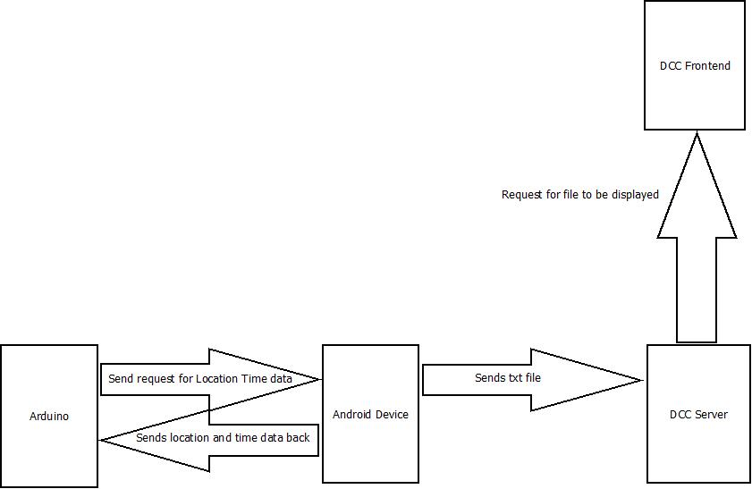
System Architecture
Notes:
Change diagram
When the sensors on the Arduino pick up an object within a close proximity to the cyclist it will send the distance over to the android device. The android device will take the distance a log it along with date, time and location onto it’s local storage. Either when the user specifies or automatically when connected via wifi the android device will send the data it’s collected to the server. The DCC front end will then request the data from the server to load up on a map to be viewed.

Slide 9
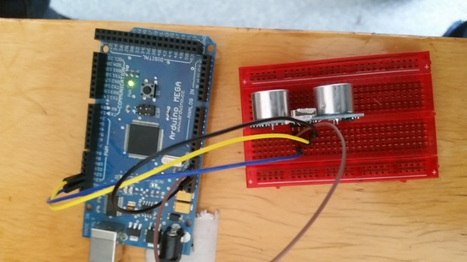
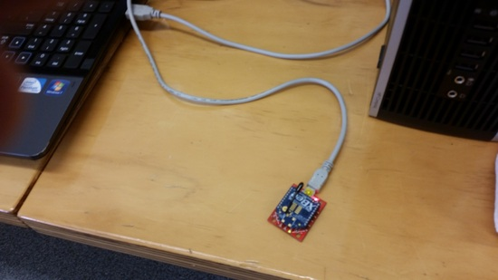
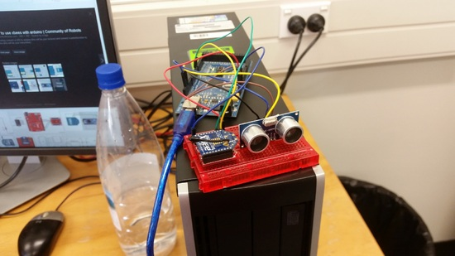
Stable Platform
We are currently using a HC-SR04 sonar sensor
Proof of concept of wireless transmission using xbees
Notes:
For our stable platform we have gotten the HC-SR04 sensor working with the NewPing libaray. Using this we are able to get distances of objects that move infront of the sensor.
We connected an Xbee to the Arduino which allowed us to wirelessly send data to another nearby Xbee which is just a proof of concept of being able to wirelessly send data.

Slide 10
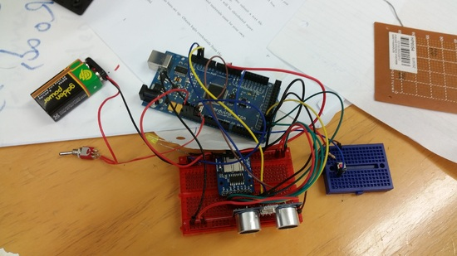
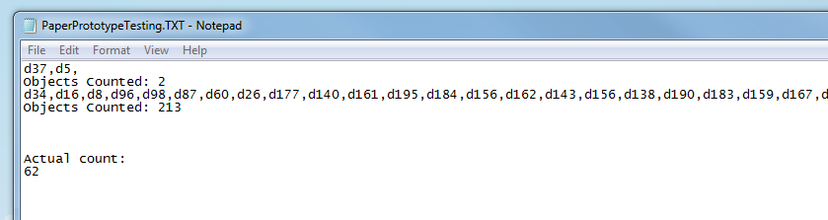
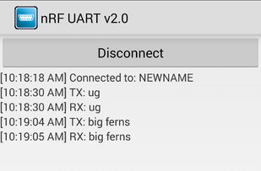
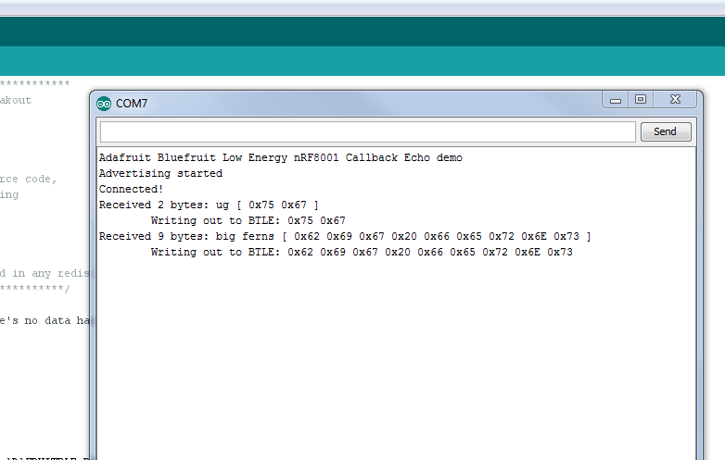
Stable Platform
We have data writing to SD card
Arduino communicating with android phone via bluetooth
Notes:
We were able to get the Arduino to store logged information into the SD card that we had attatched to show that we are capable of storing data. Although we’ve decided now that we will store data onto the android device instead of the Arduino since it makes more sense rather than pointlessly transmitting data back and forth between the two when the data needs to end up on the android device anyway.
Also for our stable platform we connected a Bluetooth device onto the Arduino to test a different method of sending data wirelessly and a method that can easily be used to connect to an android device. We were able to load up an application on a phone and connect the phone to the Arduino. We were then able to send data between the two so this showed that it was a possible path to travel down.

Slide 11
Development Pathway/MVP
To get our current system mobile and recording real world data
Portable
Notes:
For our minimum viable product we will have the Arduino set up to send a signal to the android device with the proximity of an object whenever the object gets too close. We will have the android device log the distance with the time and location. With this we should be able to start collecting proper data and to get our product in use.

